Slide 1




HOPE TO SKILL
Lecture 32
Recurrent
Neural Networks (RNNs)
Artificial Intelligence Advance Course

Slide 2
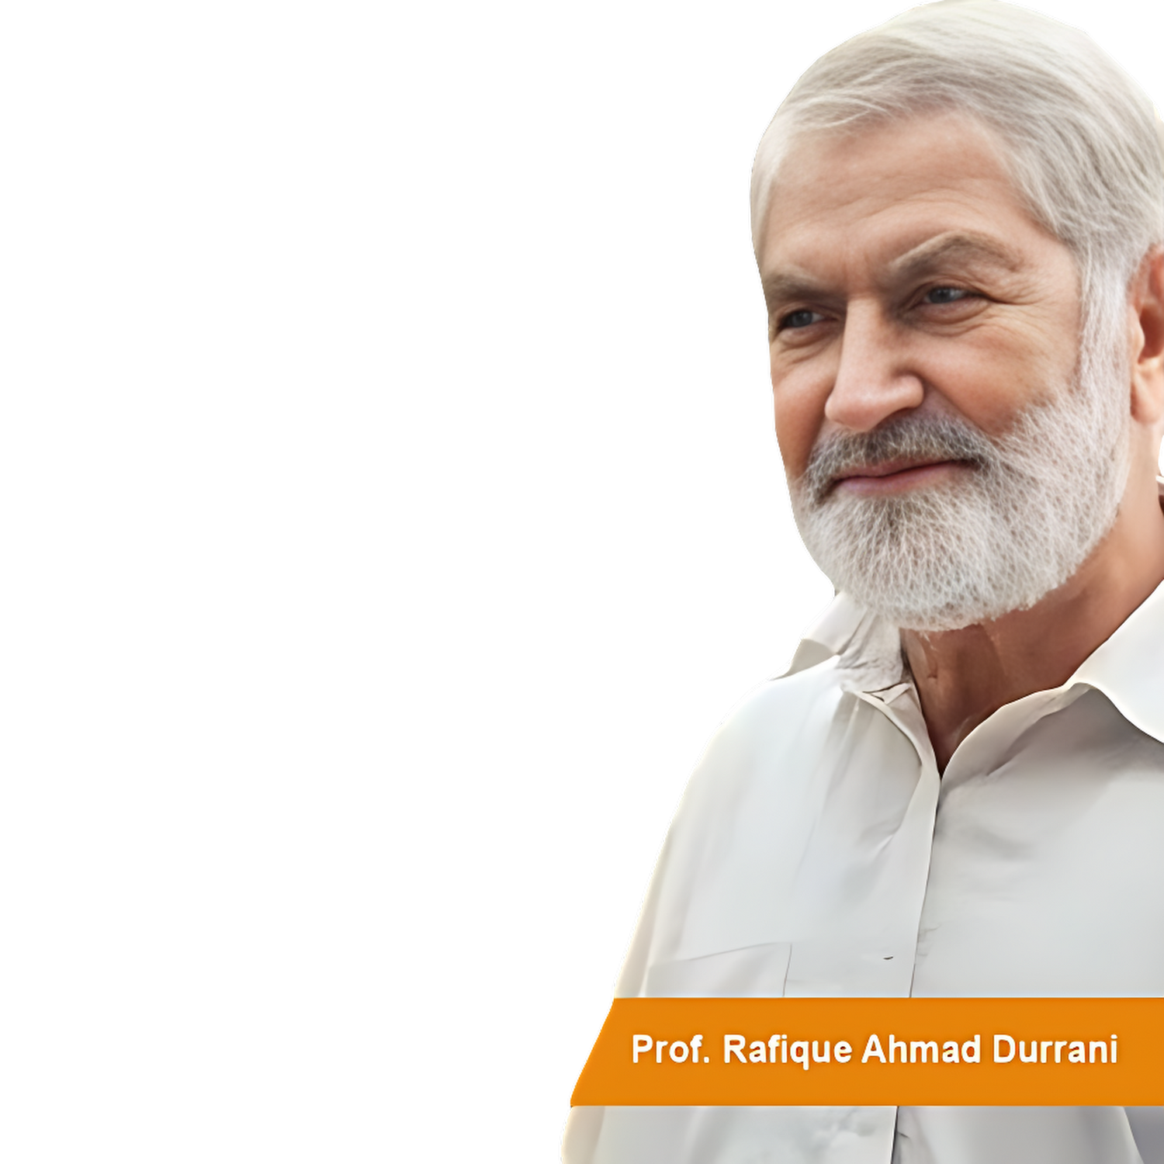


Dedicated to my late Teacher, a beacon of Knowledge.
Your Guidance shaped me; now I shape others through
a free course.
YOUR LEGACY LIVES ON!

Slide 3




AI INSTRUCTORS
Dr.Irfan Malik
Dr.Sheraz Naseer
Dr.Shazia Saqib
M.Haris Tariq

Slide 4



Previous Lecture Topics
01
Autoencoders Limitations
02
Variational Autoencoder
03
Practical Implementations

Slide 5
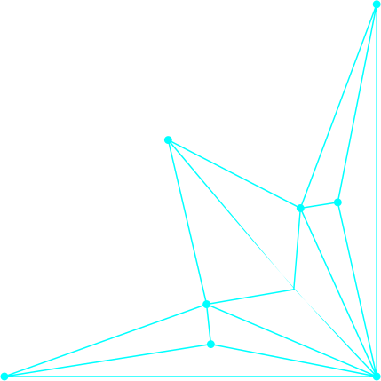


Outline
Recurrent Neural Networks
Time series data
RNN Architecture
Applications of RNN
Long Short-Term Memory (LSTM)

Slide 6
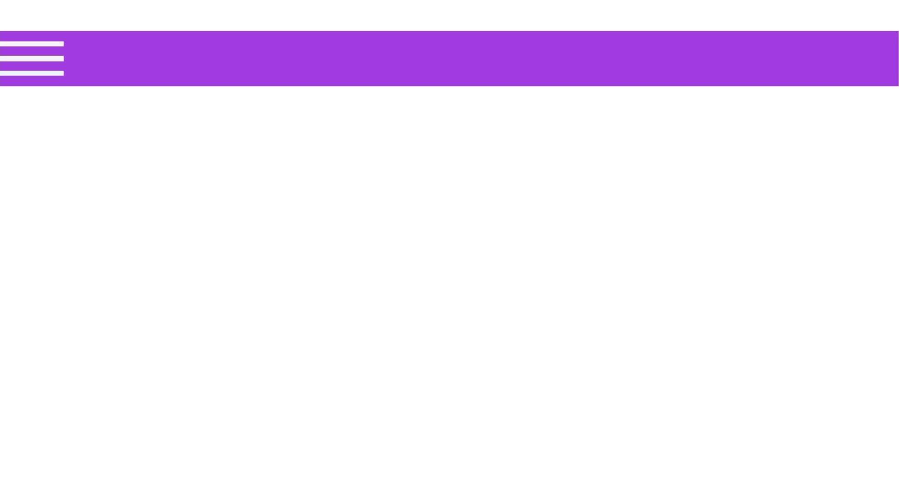
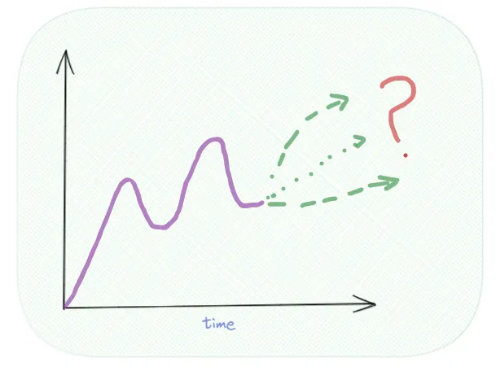
Problem
Predicting future values based
on past time-ordered data.
Applications:
Stock prices
weather
sales

Slide 7

Time Series/Sequential Data
Machine Translation :
English :Where there is a will, there is a way
Urdu : جہاں چاہ وہاں راہ
English :Actions speak louder than words
Urdu : عمل الفاظ سے بڑھ کر ہوتا ہے

Slide 8
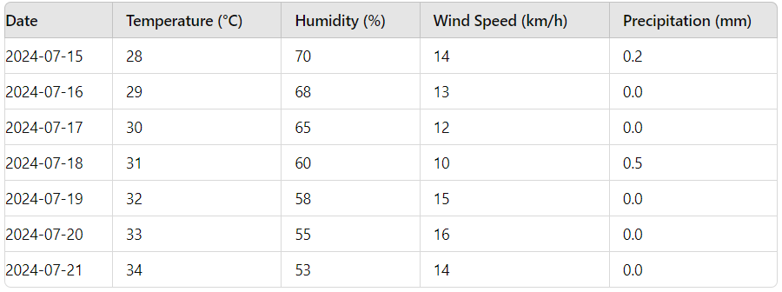
Time Series/Sequential Data
Weather Prediction : Predict Temperature for 2024-07-22

Slide 9
Time Step
A time step is a single point in a sequence of data, representing a specific moment in time.
Importance: Each time step is used to predict the next step in time series analysis.
Example:
Time Series Data: Daily temperatures over a week.
Time Steps:
Day 1: 25°C
Day 2: 26°C
Day 3: 24°C
Day 4: 27°C
Day 5: 25°C
Day 6: 26°C

Slide 10


Time Series Analysis
Can Feed Forward NN predicts the future value by using the historical data?
Answer: NO
Issues in the feed forward neural network:
Can’t handle sequential data.
Consider only current input.
Can’t memorize the previous input.

Slide 11
Time Series Analysis
Is there any model that can work on
series data?
Answer: Yes Recurrent Neural
Networks

Slide 12
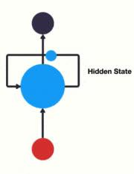
Recurrent Neural Network (RNN)?
Recurrent Neural Networks (RNNs) are a class of neural networks designed to recognize patterns in sequences of data, such as time series or natural language.

Slide 13
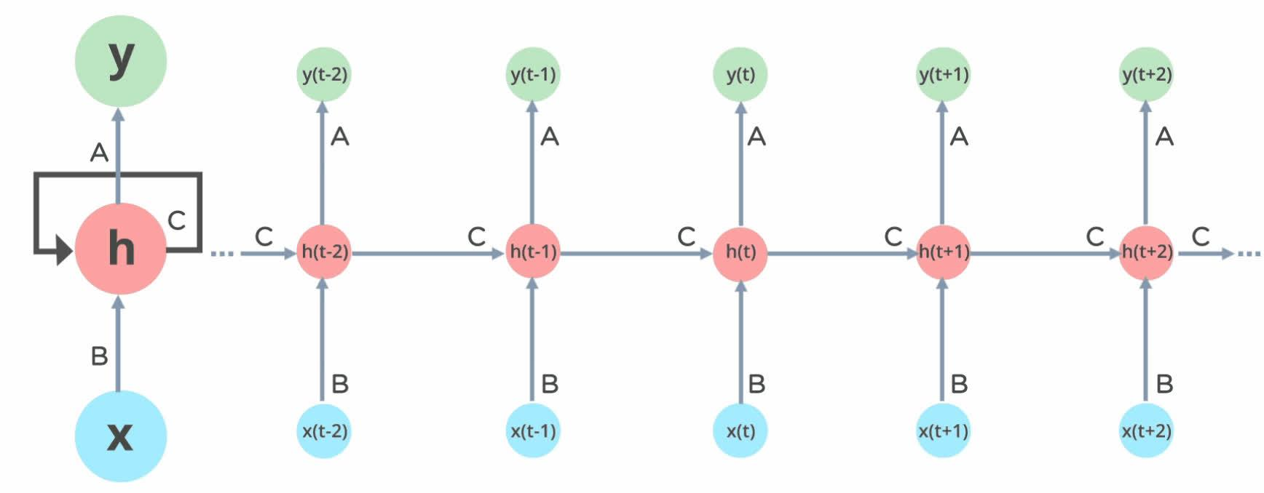
Recurrent Neural Network (RNN)?
Recurrent Neural Networks (RNNs) are a class of neural networks designed to recognize patterns in sequences of data, such as time series or natural language.

Slide 14
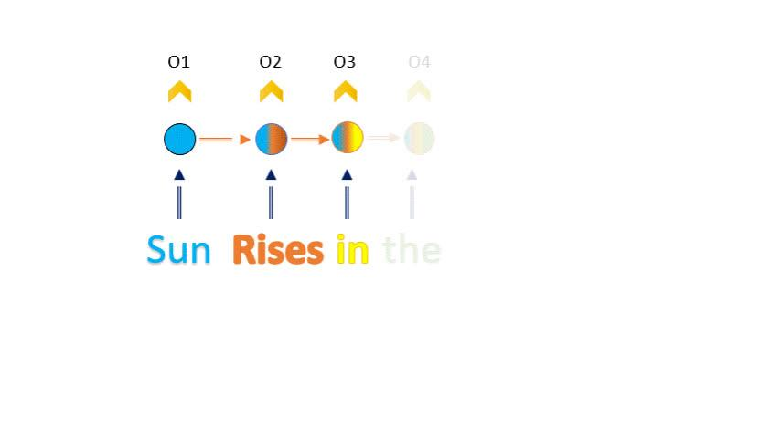
Example

Slide 15
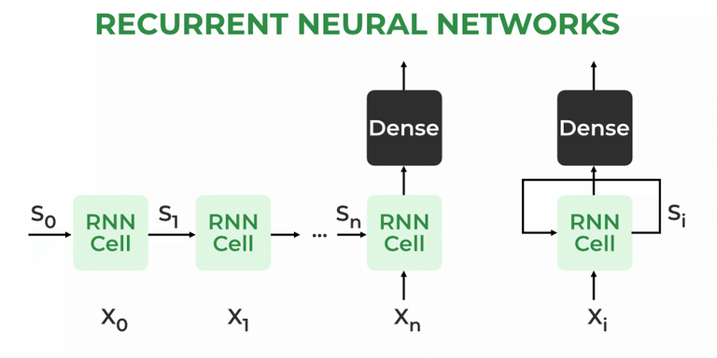
Key characteristics of RNNs
RNNs have an internal state (memory) that captures information about previous inputs, making them well-suited for tasks involving sequential data where context is crucial.

Slide 16
What Makes RNNs Special?
Recurrent Neural Networks (RNNs) distinguish themselves from other neural networks with their unique features:
Internal Memory
Sequential Data Processing
RNNs can remember past
inputs and use this
context when processing
new information, which is
their key feature.
RNNs excel with sequential
data and are ideal for tasks
like speech recognition,
machine translation, NLP,
and text generation.

Slide 17
What Makes RNNs Special?
Recurrent Neural Networks (RNNs) distinguish themselves from other neural networks with their unique features:
Contextual Understanding
Dynamic Processing
RNNs analyze current inputs
with previous ones, offering
crucial context where meaning
depends on prior
information.
RNNs update their memory
with new data, adapting
to changing patterns in
a sequence.

Slide 18




Applications of RNNs
Natural Language Processing (NLP)
Text generation
Sentiment analysis
Time Series Prediction
Speech Recognition

Slide 19
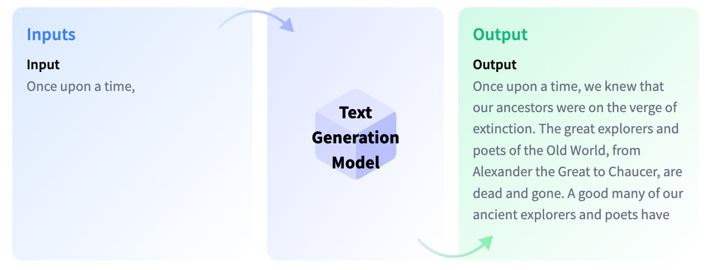
Text Generation
RNNs generate coherent text by predicting the next word based on previous words, useful for writing assistants, story generation, and chatbots.

Slide 20
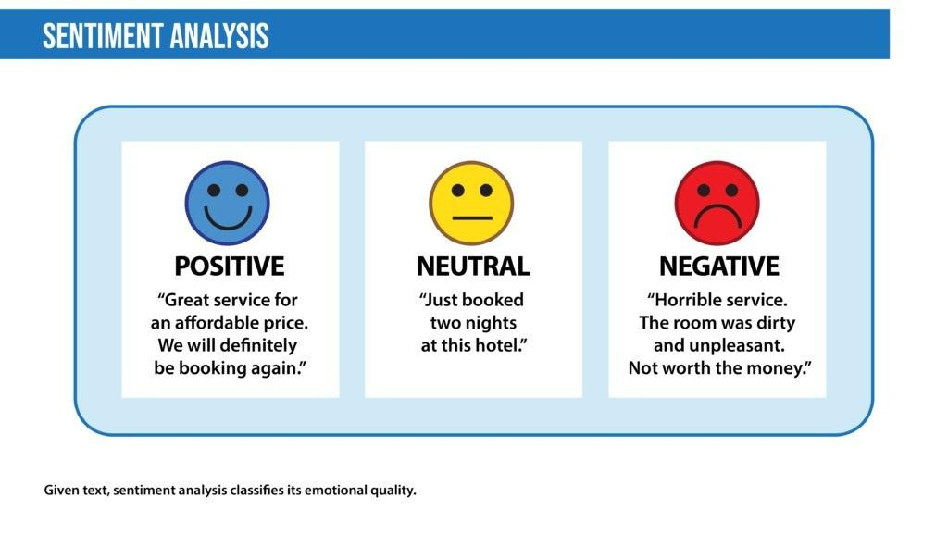
Sentiment Analysis
By processing text data sequentially, RNNs can analyze the sentiment of a given text (positive, negative, or neutral) based on the context provided by preceding words, useful for tasks like social media monitoring and customer feedback analysis.

Slide 21

Speech Recognition
RNNs transcribe spoken language into text by capturing temporal dependencies in audio signals, recognizing phonemes, words, and sentences. This forms the basis for voice-activated systems like virtual assistants (e.g., Siri, Alexa) and automated transcription services.

Slide 22

Time Series Prediction
RNNs excel at predicting future values of time series by analyzing historical data, making them valuable in finance, weather forecasting, and demand prediction. Their ability to retain past information enables accurate forecasting of trends and anomalies.

Slide 23

Types of RNN Cells
1
LSTM
Different types of RNNs
2
GRU

Slide 24
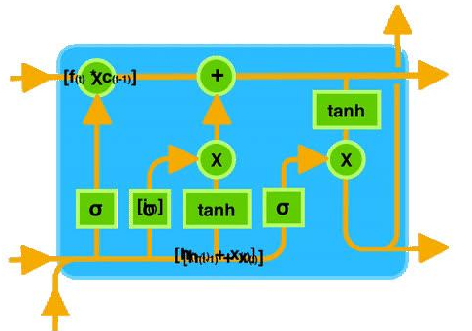
Long Short-Term Memory (LSTM)
LSTM networks introduce memory cells and gates (input, forget, and output gates) to control the flow of information, effectively mitigating the vanishing gradient problem and capturing long-term dependencies

Slide 25
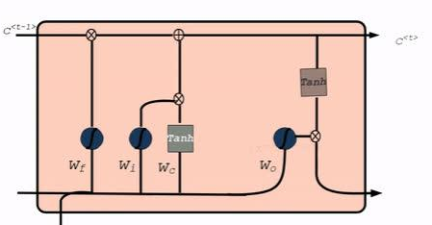
Gated Recurrent Unit (GRU):
GRU is a simplified version of LSTM with fewer gates (reset and update gates), which makes it computationally more efficient while still handling long-term dependencies well.

Slide 26
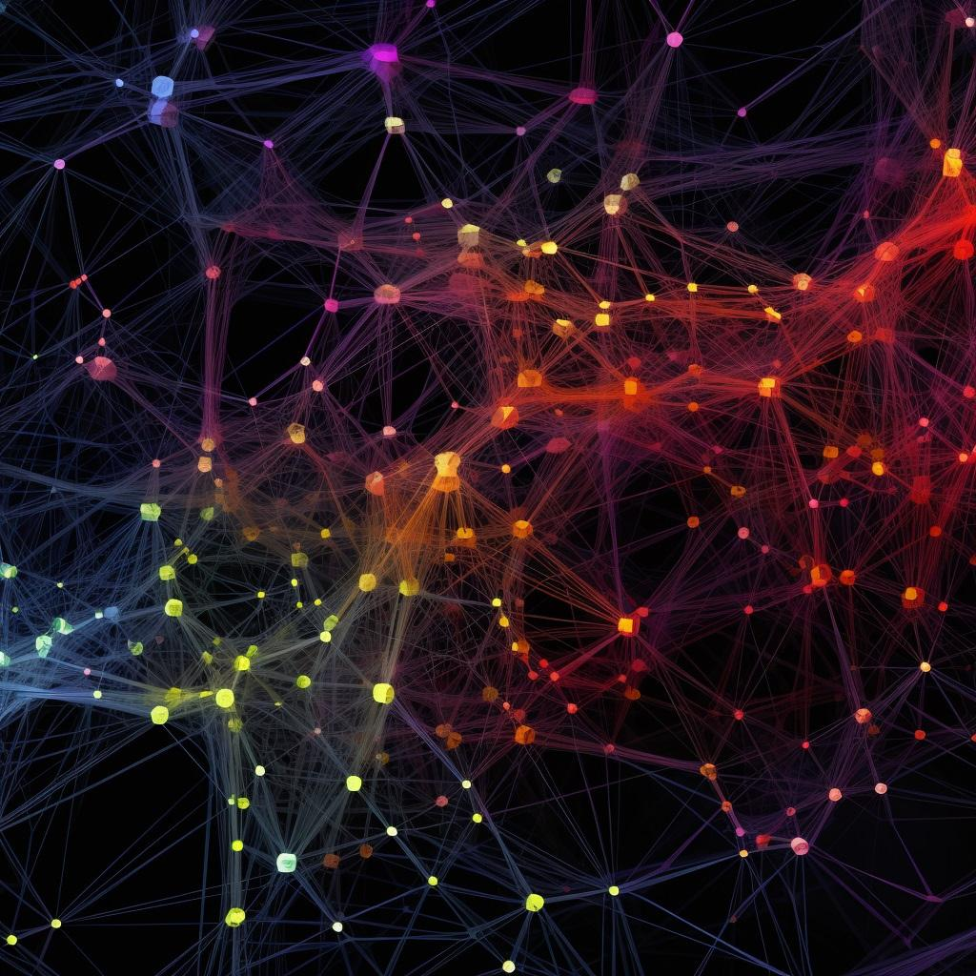


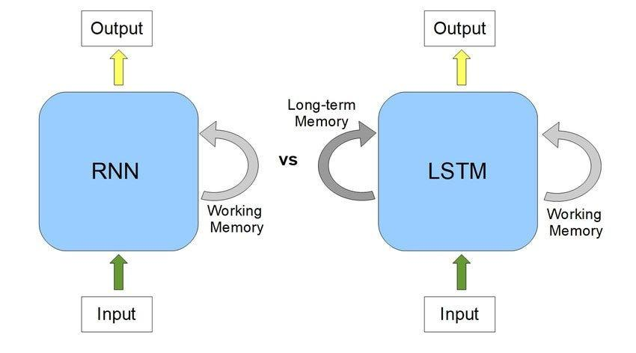
Advantages of LSTM over Vanilla RNNs
Selective Memory:
LSTMs can selectively
remember and forget
information, which allows
them to focus on relevant
data and ignore noise.

Slide 27
Quiz-1
Quiz-2

Slide 28


Conclusion
Recap of
key points
Future trends
in RNN research
Q&A
session

